Slide 1
CHAPTER FOUR MEMORY AND FORGETTING

Slide 2
5.1 Memory
5.1.1 Meaning and Processes of Memory
Memory is the retention of information learned earlier over time.
It is the way in which we record the past for later use in the present.
Memory is a blanket label for a large number of processes that form the bridges between our past and our present.

Slide 3
Processes of Memory
a) Encoding: refers to the form (i.e. the code) in which an item of information is to be recorded/placed in memory.
In encoding we transform a sensory input into a form or a memory code that can be further processed.
b) Storage: It is the location in memory system in which material is saved. Storage is the persistence of information in memory.
c) Retrieval: is the point at which one tries to remember a particular information (brought into awareness and used) from among all the others we have stored.

Slide 4
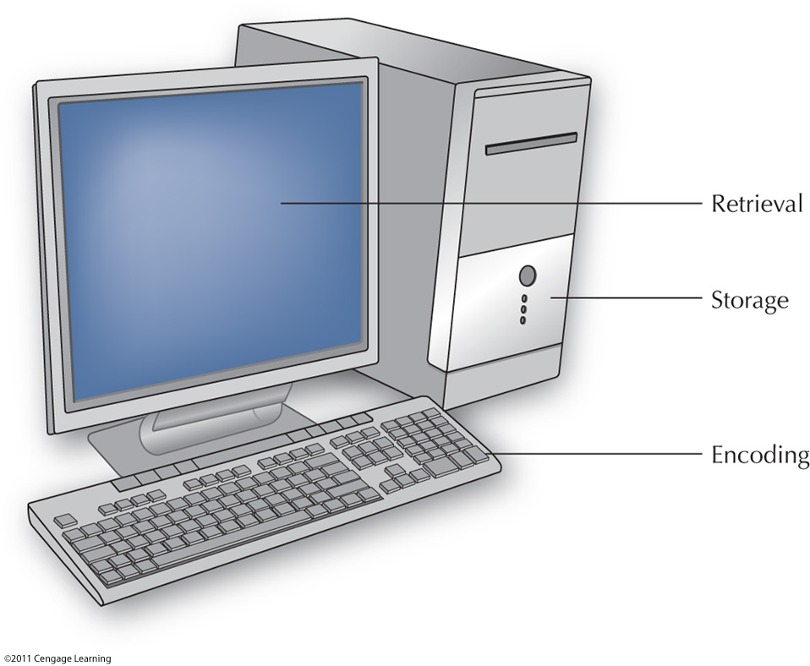

Slide 5
5.1.2 Stages/Structure of Memory
Memory structure refers how information is represented in memory and how long it lasts and how it is organized.
Many cognitive psychologists relate the mind to a digital computer that takes items of information in processes or in stages, and then produces an output.
Models of memory based on this idea are Information processing models/theories.
Like computer, we also store vast amounts of information in our memory storehouse. From this storehouse, we can retrieve some information onto a limited capacity of working memory (consciousness).

Slide 6
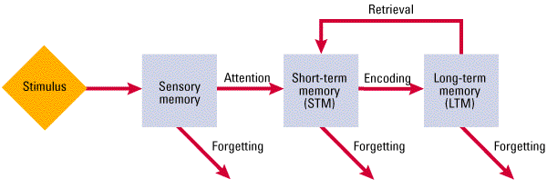
Three Stages of Memory
Three memory stores that differ in function, capacity and duration
Notes:
Hockenbury slides (Schulman)
Key words: modal model of the mind; stage model of memory; sensory memory; short-term memory; working memory; long-term memory; attention; encoding; maintenance rehearsal; retrieval

Slide 7
.
According to Atkinson and Shiffrin (1968), memory has three structures:
1) Sensory Memory/Sensory Register: It is the entry way to memory, where information stay for a brief time (until we select it for attention).
Sensory memory hold virtually all the information reaching our senses for a brief time. For instance,
Visual images (Iconic memory) remain in the visual system for a maximum of one second.
Auditory images (Echoic memory) remain in the auditory system for a slightly longer time, by most estimates up to two second or so.
The information stored in sensory memory is a fairly accurate representation of the environmental information but unprocessed.
Most information briefly held in the sensory memory simply decays from the register. Those information that has got attention and recognition pass on short-term memory for further processing.

Slide 8
.
Short term memory is distinguished by four characteristics:
It is active - information remains in STM only so long as the person is consciously processing, examining, or manipulating it. People use STM as a “workspace” to process new information and to call up relevant information from LTM.
Rapid accessibility - Information in STM is readily available for use. The difference between STM and LTM is the difference between searching for information in an open computer file versus file stored on the hard drive.
Preserves the temporal sequence of information-STM usually helps us to maintain the information in sequential manner for a temporary period. It keeps information fresh until it goes to further analysis and stored in LTM in meaningful way.
Limited capacity-the number of items that short-term memory can handle at any one time is small - about “7 plus or minus 2” pieces of information at a time (Miller,1956).

Slide 9
...
According to most models of memory, we overcome this problem, by grouping small groups of information into larger units or chunks.
Chunking is the grouping or “packing” of information into higher order units that can be remembered as single units.
Chunking expands working memory by making large amounts of information more manageable.
A chunk may be a word, a phrase, a sentence, or even a visual image, and it depends on previous experience.
STM memory holds information (sounds, visual images, words, and sentences and so on) received from SM for up to about 30 seconds by most estimates.
It is possible to prolong STM indefinitely by rehearsal- the conscious repetition of information. Material in STM is easily displaced unless we do something to keep it there.

Slide 10
.
2) Short-term Memory: is part of our memory that holds the contents of our attention.
Unlike sensory memories, short-term memories are not brief replicas of the environmental message. Instead, they consist of the by-products or end results of perceptual analysis.
STM is important in a variety of tasks such as thinking, reading, speaking, and problem solving.
There are various terms used to refer to this stage of memory, including working memory, immediate memory, active memory, and primary memory.
Maintenance Rehearsal: Repeating information silently to prolong its presence in STM
Elaborative Rehearsal: Links new information with existing memories and knowledge in LTM
Good way to transfer STM information into LTM

Slide 11
3. Long Term Memory
It is a relatively permanent storage of meaningful information. The capacity of LTM seems to have no practical limits. The LTM is assumed to be composed of different sub systems:
Declarative/explicit memory-the conscious recollection of information such as specific facts or events that can be verbally communicated. Declarative memory is subdivided into semantic and episodic memories.
Semantic memory-memories of meaning of words, concepts and our knowledge of the world, independent of any particular context.
Episodic memory-memories of events and situations.
Non-declarative/implicit memory-refers to memory without awareness; memory that affects behavior but cannot consciously be recalled.
One of the most important kinds of implicit memory is procedural memory (habitual responses).

Slide 12
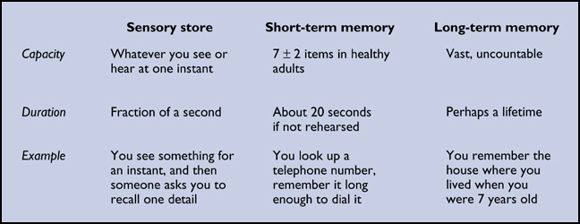

Slide 13
.
Serial Position Effect If you are shown a list of items and are then asked immediately to recall them, your retention of any particular item will depend on its position in the list.
That is, recall will be best for items at the beginning of the list (the primacy effect) and at the end of the list (the recency effect). When retention of all the items is plotted, the result will be a U-shaped curve.
According to Serial Position Effect or the three-box model, the first few items on a list are remembered well because short-term memory was relatively “empty” when they entered. The last few items are remembered for a different reason: At the time of recall, they are still sitting in STM.
The items in the middle of the list, however, are not so well retained because by the time they get into LTM, it is already crowded. As a result many of these items drop out of STM before they can be stored in LTM.

Slide 14
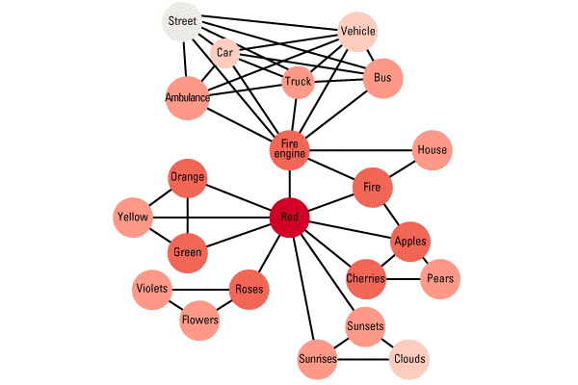
Semantic Networks
A complex web of semantic associations that link items in memory such that retrieving one item triggers the retrieval of others as well .

Slide 15
5.1.3 Factors Affecting Memory
Memory is a process which includes learning, retention and remembering. These processes are important for good memory.
Eleven Factors that Influence Memory Process are as follows: a. Ability to retain/past experience b. Good health c. Age of the learner d. Maturity e. Will to remember f. Intelligence
g. Interest h. Over learning i. Speed of learning j. Meaningfulness of the material
k. Sleep or rest

Slide 16
5.2 Forgetting 5.2.1 Meaning and Concepts of Forgetting
In our daily living, we encounter so much information. If we attempt to encode, store & recall all the info, we are in trouble.
Hence, we are selective in storing and forgetting information. Sometimes we are motivated to forgot something and recall what we want to remember. Psychologists call this phenomenon as motivated forgetting.
Psychologists generally use the term forgetting to refer to the apparent loss of information already encoded and stored in the long-term memory.
According to Ebbinghaus (1885), the most rapid forgetting occurs in the first hours, and particularly in the first hour f learning. After nine hours, the rate of forgetting slows.
Furthermore, relearning of previously mastered material is almost always faster than starting from a scratch.

Slide 17
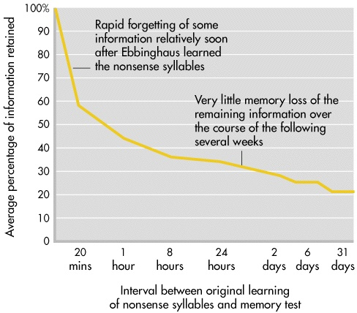
The Forgetting Curve
Hermann Ebbinghaus first began to study forgetting using nonsense syllables
Nonsense syllables are three-letter combinations that look like words but are meaningless (ROH, KUF)

Slide 18
5.2.2. Theories of Forgetting
Psychologists identified the following five mechanisms of forgetting: The Decay Theory: The decay theory holds that memory traces or engram fade with time if they are not - accessed now and then. In decay, the trace simply fades away with nothing left behind, because of the passage of time. Interference theory: Interference theory holds that forgetting occurs because similar items of information interfere with one another in either storage or retrieval. It may be proactive or retroactive.
In Proactive Interference, information learned earlier interferes with recall of newer material. In Retroactive Interference, new information interferes with the ability to remember old information New Memory for Old/ Displacement Theory: This theory holds that new information entering to memory can wipe out old information. This works for STM, where the capacity for information is limited to seven plus or minus chunks. It cannot work for LTM having virtually unlimited capacity.

Slide 19
.
Motivated Forgetting: According to Freud, it is blocking of those memories from consciousness that are two threatening or painful to live with, and he called this self-protective process of Repression. Today many psychologists prefer to use a more general term, motivated forgetting.
Cue Dependent Forgetting: refers forgetting due to lack of retrieval cues in which we may feel as if we have lost the call number for an entry in the mind‘s library.
That may also explain why remembering is often easier when you are in the same physical environment as you were when an event occurred.

Slide 20
5.3. Improving Memory
Some simple mnemonics/memory aids are useful, but complicated ones are often more bothersome than benefitting. A better approach is to follow some general guidelines.
Pay Attention: We often fail to remember because we never encoded the information in the first place.
Encode information in more than one way/Add meaning: The more elaborated (meaningful) the material, the more likely it is to link up with information already in long-term memory.
Take your time: Minimize interference by using study breaks for rest. Sleep is the ultimate way to reduce interference.
Over learn/Practice : Studying information even after you think you already know it.

Slide 21
…
Monitor your learning (SQ3R): By testing yourself frequently, rehearsing thoroughly, and reviewing periodically, you will have a better idea of how you are doing
Increase the Depth of Processing
Hierarchical Organization
Verbal Mnemonics
Method of Loci
Peg-Word Method
Minimize Interference
Utilize Context Effects

